Slide 1

The Agile Manifesto
We are uncovering better ways of developing product by doing it and helping others do it. Through this work we have come to value:
Individuals and interactions over processes and tools Working product over comprehensive documentation Customer collaboration over contract negotiation Responding to change over following a plan
That is, while there is value in the items on the right, we value the items on the left more.
Source: https://agilemanifesto.org/

Slide 2
The Agile Manifesto
1
Our highest priority is to satisfy the customer through early and continuous delivery of valuable product.
2
Welcome changing requirements, even late in development. Agile processes harness change for the customer’s competitive advantage.
3
Deliver working product frequently, from a couple of weeks to a couple of months, with a preference to the shorter timescale.
Business people and developers must work together daily throughout the project.
Build projects around motivated individuals. Give them the environment and support they need, and trust them to get the job done.
4
5
The most efficient and effective method of conveying information to and within a development team is face-to-face conversation.
6
Working product is the primary measure of progress.
7
Agile processes promote sustainable development. The sponsors, developers, and users should be able to maintain a constant pace indefinitely.
8
The best architectures, requirements, and designs emerge from self-organizing teams.
9
Continuous attention to technical excellence and good design enhances agility.
11
Simplicity – the art of maximizing the amount of work not done – is essential.
10
At regular intervals, the team reflects on how to become more effective, then tunes and adjusts its behavior accordingly.
12
Source: https://agilemanifesto.org/
Notes:
Exercise:
Break into groups
As a team, select 3-4 principles that resonate with you
Be prepared to discuss with the class

Slide 3

Continuous Improvement
Remember our Agile Manifesto principle:
At regular intervals, the team reflects on how to become more effective, then tunes and adjusts its behavior accordingly
This is not just about a Retrospective at the end of a timebox; it refers to the continuous improvement nature of any Lean or Agile process
The Team gets to look at what is working with the current process, what is not working, and then makes adjustments that they can immediately put into practice
In order to continue providing value to our customers and clients, it is important that we continue to re-evaluate ourselves as well

Slide 4
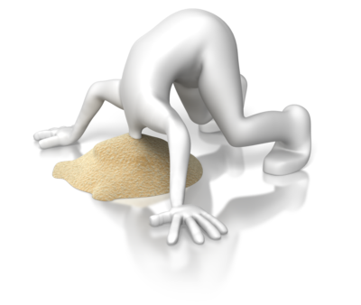
Continuous Improvement
Empirical Process Model
Transparency – good, bad, and ugly
Inspection – review results based on data and observations
Adaptation – small incremental changes; evolve
Daily Scrum
NOT a status meeting – it’s all about the team
Inspect and Adapt + 24-hour plan
Retrospective
What went well
What didn’t
How do we get better
Respectfully question authority
Slack-time
100% capacity = no time to improve
Allow time to improve skills, knowledge, process, and teamwork

Slide 5
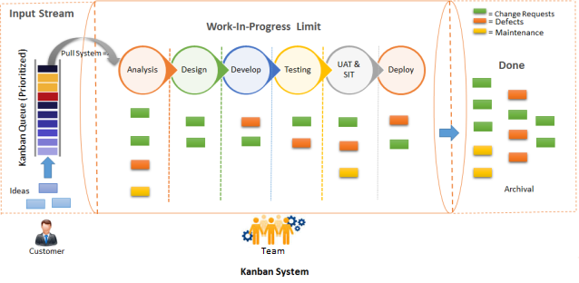
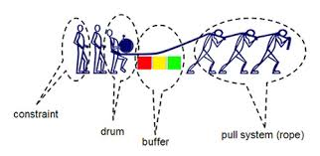
Push vs. Pull
Unlike a “push” system, where work is given to a person and put into a massive “to-do” list, pull systems allow the person doing the work to pull in tasks as they are ready. This prevents people from feeling overloaded and forces teams to prioritize.
Stop Starting; Start Finishing! EMPOWER the team!
Notes:
Exercise:
Instructor will provide instructions.
Pull systems reduce multi-tasking by allowing the team member to take on another task only when the first is completed.

Slide 6




Scrum
Daily Scrum
Every 24 hours
Potentially Shippable Increment
Product Backlog
Sprint Backlog
Sprint
2 Weeks
Sprint Planning Meeting
Backlog Refinement
Meeting
Sprint Review Meeting
Sprint Retrospective Meeting
Adapted from: commons.wikimedia.org/
Notes:
Scrum as a Framework
Some Vocabulary:
Backlog Item: An incremental unit of work delivered to a potentially shippable state during the course of a Sprint
Sprint: A predefined 1-4 week period within which work gets completed
Potentially Shippable: The ability at the end of each sprint to introduce whatever was built into a production environment
Shippable: The ability to place a feature rich Minimal Viable Product into the hands of the consumer
MVP: Minimal Viable Product
Backlog Item = Story = User Story = Feature = Requirement
Sprint = Iteration = Timebox = Window
Roles:
Product Owner: Owns the vision, backlog content and priority (Build the right thing)
Team: People doing the work. Own the product increment/delivery (Build it right)
Scrum Master: Process champion, facilitator, team coach (Build it fast)

Slide 7

The Team
Contains everyone necessary to develop the solution
Everyone is PART of the team
Cross-functional – not a team of specialists (SM, PO, Dev, QA, Analysts)
Self-organizing
Typically small (<=10)
Co-located (ideally)
The Team is collectively responsible for the success of each Sprint and the project as a whole.
Notes:
Small Teams: 7 +/- 2
Roles: Product Owner, Scrum Master, Team
Team members have complementary skills
Committed to a common purpose “shared ownership”
Create a shared vision for the team
Set realistic goals
Limit team size
Build a sense of team identity
Provide strong leadership
They are self-organizing, rather than role or title based
They are empowered to make a decision
They truly believe that, as a team, they can solve any problem
They are committed to team success vs. success at any cost
The team owns its decisions and commitments
Trust vs. fear or anger motivates them
They are consensus-driven with full divergence and then convergence
They live in a world of constructive disagreement
Team morale is a velocity multiplier

Slide 8

The Product Owner
Is part of the Team
Representative from the business
Determines the product vision
Acts as the customer/user representative
Is responsible for:
Identifying and prioritizing the Product Backlog
Identifying acceptance criteria for items on the backlog
Working closely with the team to clarify items on the backlog if needed

Slide 9

The Scrum Master
Ensures that the team is following Scrum practices
Is responsible for removing any obstacles / impediments that are keeping the team from making progress
Does not have authority over the team
Serves as a coach to the team

Slide 10



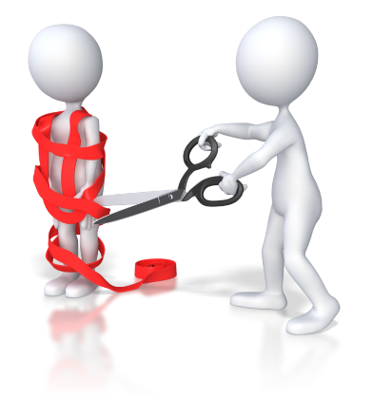

Extended Roles
Stakeholders
Collaboration
Ideas
Value
Build the right thing
Build the thing right
PO
Team
SM
Leadership
Program Managers
Build it fast
Notes:
Leadership clears the path
Program managers coordinate across teams and initiatives
Stakeholders provide vision and direction for the product(s)

Slide 11
Agile Planning

Slide 12

Purpose: Select work from the roadmap/backlog for the release Preparation: Prioritized and estimated backlog Product Owner ready to discuss details Release timebox (how many sprints) Execution: Review each epic by priority Select stories and add to sprints Validate velocity
Release Planning
Timebox: 2-4 hours
Notes:
Plan multiple sprints.

Slide 13

Purpose: Select what work is to be done, prepare details for how work will be implemented, make team commitment. Preparation: Participation is critical Prioritized and estimated backlog Release Plan (optional) Product Owner ready to discuss details Execution: Review each story by priority Estimate in Story Points (as needed) Identify specific tasks for each story Estimate tasks in ideal hours Compare to actual capacity available
Sprint Planning
Notes:
Plan the sprint.

Slide 14

Daily Standup
Timebox: 15 minutes + breakout
Purpose: Planning and inspect and adapt forum. Used to raise issues, not solutions.
Preparation: Tools updated
Rules:
Same time and place every day – use the timebox
Whole team present, including PO
Always be on time!
No problem solving
No electronics
Only team can talk
Execution: 3 Questions, or “Walk the Board”
Notes:
Plan the day.
Whole team should be present
Others not recommended, but can attend if they follow the rules

Slide 15

Purpose: Elaborate and refine work for future sprints. Make stories “Sprint Ready”. Preparation: Participation is critical Prioritized backlog Product Owner ready to discuss details Execution: Partial team for early refinement, whole team for estimating Review each story by priority Ask questions Split epics as necessary Document in acceptance criteria Estimate
Backlog Refinement
Notes:
Prepare work for future sprints.

Slide 16

Sprint Review/Demo
Purpose:
Showcase working product to stakeholders. Excellent forum for new stories. Enhances quality of product and builds trust with stakeholders.
Preparation:
Metrics
Working product
Execution:
Discuss metrics
Discuss what is not done and why
Delivery team demos working software
Welcome feedback
Collect new user stories
Timebox: 1-2 hours
Your
Product
Here
Notes:
Inspect the product increment and gain feedback.

Slide 17

Retrospective
Timebox: 1-2 hours
Purpose: Inspect and adapt forum. Opportunity to improve process and teamwork.
Rules:
Bring ideas
Must be safe environment
Execution:
What worked well?
What did not work well?
What will we improve?
Notes:
How do we get better?
Must be a safe meeting (able to say what needs to be said).
What worked well?
Focus on the team, not the product
What did not work well?
Recognize failed attempts to improve
Identify performance impediments
What will we improve?
Keep a backlog
Iterate – choose just a few items per iteration

Slide 18
Cadence Calendar
Sprint 1
Sprint Planning | Daily Standup | Daily Standup, Story Refinement | Daily Standup | Daily Standup
Daily Standup | Daily Standup | Daily Standup, Story Refinement | Daily Standup | Sprint Review, Sprint Retrospective
No Gap
Sprint 2
Sprint Planning | Daily Standup | Daily Standup, Story Refinement | Daily Standup | Daily Standup
Daily Standup | Daily Standup | Daily Standup, Story Refinement | Daily Standup | Sprint Review, Sprint Retrospective
Notes:
Series of recurring meetings on a cadence
Refinement meetings can be more or less, depending on the quality of the backlog

Slide 19
Defining Product Vision
Vision | What is the purpose for creating the product? Which positive change should it bring about?
Target Group Which market or market segment does the product address? Who are the target customers and users? | Needs What problem does the product solve? Which benefit does it provide? | Product What product is it? What makes it stand out? Is it feasible to develop the product? | Business Goals How is the product going to benefit the company? What are the business goals?
Source: https://romanpilcher.com
Notes:
The vision helps set high-level expectations for the stakeholders and the team.
The vision should express:
Who is going to buy the product? Who is going to use the product?
What needs will the product address?
What differentiates the product from its competitors?
What are the key attributes of the product?
Exercise:
Build your product vision.

Slide 20
SAMPLE
Defining work to get to “DONE”
Vision | What is the overall goal of this value stream? Why are we doing this and what is the value?
Success Criteria | How do we measure we have achieved this value stream? How do we know we are done?
Inputs | What data will be utilized by this value stream? What integrations are needed?
Dependencies | Will we have to coordinate with other teams? Do we have a hard due date?
Technical Considerations | What systems are we working with?
Work Chunks | How can we break the work down into smaller chunks?
Customers | Who are the customers of this value stream?
Change Management Considerations | What communications do we need? Training?
Business Process Owner | Who owns acceptance testing?

Slide 21


Define the Users
Remember Manifesto Principle #1:
Our highest priority is to satisfy the customer through early and continuous delivery of valuable product.
10
9
8
7
6
5
4
3
2
1
0
*
Notes:
Exercise:
Brainstorming

Slide 22

Product Backlog
Prioritized list of all work to be performed by the team
Items are defined and prioritized by the Product Owner with input from the team
New items may be added at any time
Items may be removed at any time
Items may be re-prioritized at any time
Anyone may author an item, but the Product Owner owns its placement in the backlog

Slide 23
Defining the Product
Theme/Feature: Increase Website Traffic
Epic: Improve User Login Page Usability
Story 1: As a User, I would like the validation on the login page to be very clear so I know when I make a mistake

Slide 24
Epic Breakdown Example
Epic: As a customer, I want to re-use my personal information so that I can complete my purchase quickly; large body of work that needs to broken down
User Stories include:
As a customer, I want an account creation option to select so that I can begin the process of adding my profile
As a customer, I want to add my location details so that the system knows where to ship my purchases
As a customer, I want to add my payment details so that the system can offer a quick way for me to pay for my purchase
As a customer, I want to review and confirm my profile details so that I know I haven’t made a mistake
Notes:
For the team to deliver a user story, it must “fit” into a Sprint.
Splitting and slicing a user story into “bite-sized pieces”
Ensuring a story is “Ready”

Slide 25

Product Roadmap
Jan
Feb
Mar
Quarter 2
Release Theme A
Release Theme B
Feature 1
Feature 2
Feature 3
Product Delivery
Feature 3
Feature 4
Feature 5
Partnerships
Press Release
Marketing
Market Research
Media Campaign
10
9
8
7
6
5
4
3
2
1
0
*
Notes:
Exercise:
Break into teams and roadmap your product.

Slide 26
What is a User Story?
A User Story is a form of requirement:
It is written in such a way to give an overview of a system function and the outcome (value) the user expects to receive from the function.
3 aspects of user stories:
Card: A written description
Conversation: Conversations about the story to clarify it and flesh out the details
Confirmation: Criteria that can be used to determine when the story is completed
A User story is a promise for a conversation.

Slide 27
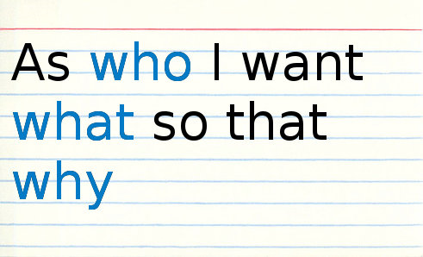
User Story Format
A user story is written in three parts:
Role – the user role for the story
Goal – what the user is trying to accomplish
Benefit – why the user wants to accomplish it

Slide 28
User Story Examples
Example 1:
As a customer, I want to create a profile so that I can have an account
Example 2:
As a customer, I want to create a profile so that I don’t have to fill in the information again when I make a purchase
Example 3:
As an administrator, I want to create a list of received orders so that I can pack and ship them

Slide 29

Types of Stories
User Request: Something that benefits the user directly, or enables a future benefit
Spike: Research, prototype, risk reduction, knowledge acquisition
Technical Debt: Things we should have done correctly the first time, but likely took a shortcut to meet a deadline

Slide 30
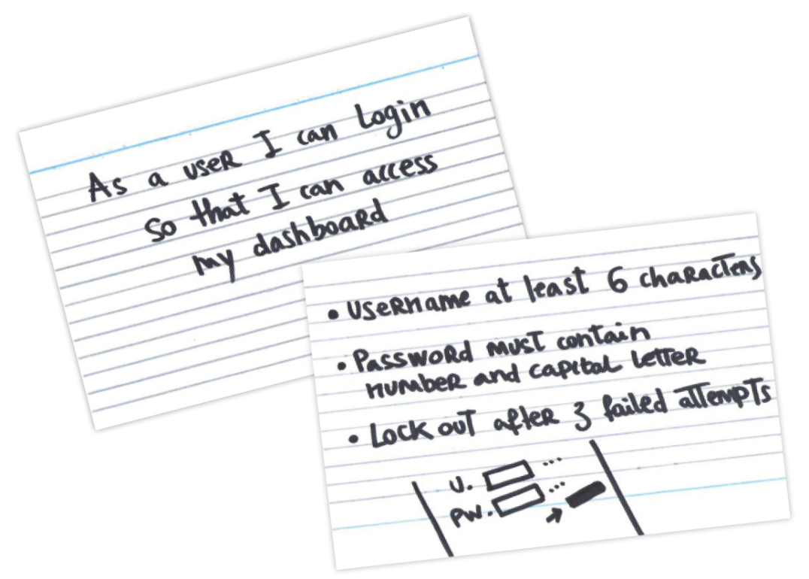
Acceptance Criteria
Acceptance criteria for a user story provide the criteria to determine if the story has been correctly and fully implemented.
Acceptance criteria provide guidance to the developers to understand how their solution should satisfy the user’s objectives.
They convey the customer’s expectations.
Given <a condition>
When I <perform an action>
Then I expect <the result>

Slide 31
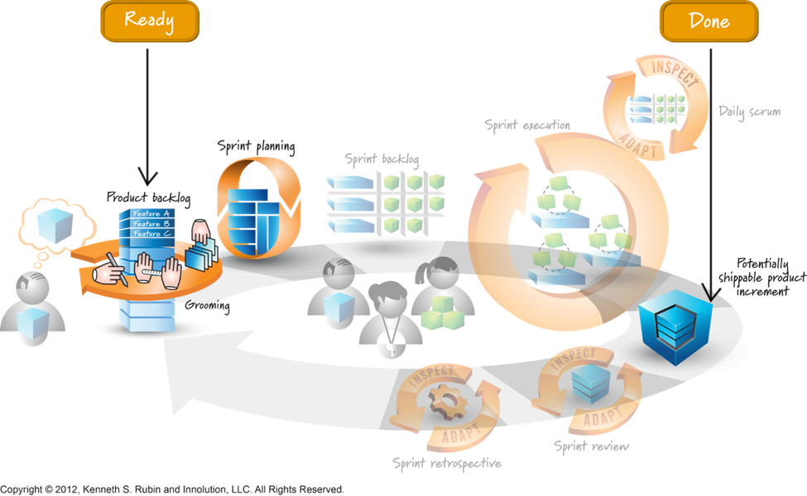
Definition of Ready (Team doesn’t work on a story until…) and Definition of Done (Story is NOT done until…)
Definition Ready Examples:
Story has Acceptance Criteria
Story has been estimated by entire team
Story has been socialized
Definition of Done:
Story has met its Acceptance Criteria
Passed QA testing
Accepted by Product Owner
Held demo to stakeholders
Notes:
Similar to tollgates
Don’t take a story into the sprint unless it meets the DoR – or is an emergency
Stories are not considered complete until they meet the DoD and the acceptance criteria

Slide 32

Ordering the Backlog
Initially, the Product Backlog should be ordered by Business Value by the Product Owner, prior to Release Planning
Business Value is subjective in nature:
Revenue it could drive
Demand from oversight institutions
Demand from prospects
Importance to end users
Frequency of use
Risk of not having the feature
Building of core capabilities
Alignment to strategy
Methodologies:
Fire Alarm
Financial Criteria (NPV, ROI, etc.)
MoSCoW
Kano Analysis
Weighted Shortest Job First (WSJF)
Risk Adjusted

Slide 33
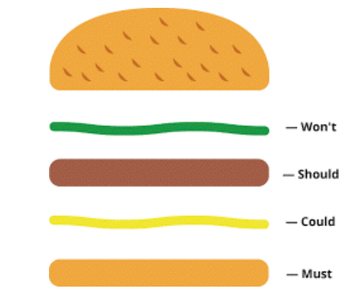
Categorization
MoSCoW:
Must Have – baseline requirements
Should Have – deliver if possible
Could Have – not critical
Would Like – Wouldn’t it be cool if…?
Kano Analysis:
Must Have – baseline requirements
Satisfiers – the more the better
Delighters – at least one or two
Dissatisfiers – don’t deliver these

Slide 34

Estimating – Story Points
Based on Size and Complexity, not time
Triangulate with other known factors
Smaller stories
Similar stories
Larger stories
Use abstract unit of measure: Story Points (1, 2, 3, 5, 8, 13, 20)
Notes:
Relative Estimating
Based on Size and Complexity, not time
Triangulate with other known factors
Smaller stories
Similar stories
Larger stories
Story Points
Abstract unit of measure
Derived collaboratively by the team
Pure measure of size – “this is like that”
Estimating in story points is typically faster
Not an infinite scale
Fibonacci (ish): 1, 2, 3, 5, 8, 13, 20, 40, 100
Doubling: 1, 2, 4, 8, 16, 32, 64, 128
Notes:
T-Shirt Sizing
T-Shirt Size
Points
XS
1
S
2
M
3
L
5
XL
8
Small Epic
13
Medium Epic
20
Large Epic
40

Slide 35

Estimating – Planning Poker (https://www.planningpoker.com)
Each estimator has a deck of cards
Product Owner describes a story and allows brief discussion
Each player selects a card for their estimate (comparing to baseline) and places it face down
All cards shown at same time to reduce influencers
Outliers discuss differences
Re-estimate until convergence

Slide 36
Estimating – T-shirt sizing
Edit the wall
Bucketize the items
Silent Relative Sizing
Challenge
Smaller
Larger
XS
S
M
L
XL
…
As a _
I want _
So that _
As a _
I want _
So that _
As a _
I want _
So that _
As a _
I want _
So that _
As a _
I want _
So that _
As a _
I want _
So that _
Notes:
Must equate t-shirts to actual numbers.
Example: XS=1, S=3, M=5, L=8, XL=13, etc.

Slide 37
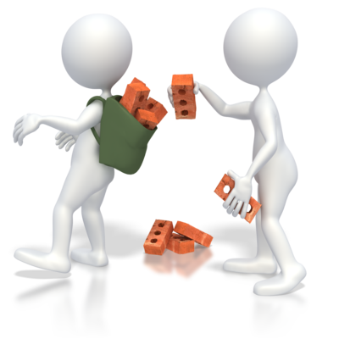
Capacity Planning
Calculate actual time available for a given sprint. Used during Sprint Planning.
Assume 6 hours per day of productive time
Discuss PTO and other commitments that need to be taken into account for capacity planning
Should be done during sprint planning
Be realistic about your capacity

Slide 38

Velocity
Represents how much work the team can finish in one sprint. Used for forecasting and Sprint Planning.
Total the points completed at end of sprint
Average the velocity across sprints
Different teams have different velocity
Estimate used for planning purposes only
Will be used to determine capacity and pace of work moving forward – how many stories can the team take on in a sustainable pace?
DO NOT USE VELOCITY AS A TEAM PERFORMANCE MEASUREMENT!!
Velocity is affected by:
Number of people
Time off
Multi-tasking

Slide 39

Metrics
Use metrics for positive reinforcement
Use the “5 Why’s”
Typical Agile Metrics:
Burndown charts
Provides visibility into work remaining
Can be produced for Release, Sprint
Burnup charts
Provides visibility into work completed
Can be produced for Release, Sprint, Epic
Completed vs. Committed
Quality Metrics
Notes:
Exercise:
What metrics do you use today and why?

Slide 40
Burndown Charts (Scrum)
Shows estimated work remaining
Represents a real-time snapshot of the progress we are making
Burndown is generated by capturing time remaining
Helps the team to recognize its cadence
Available per Release, Sprint or Individual
Forces the right conversation to happen early
What can we do about it?
What is needed to get back on track?
Help from each other? Help from the PO? Help from another group or Stakeholder?

Slide 41
Next Steps
Conduct agile pilot on following priority areas:
Fund Down
Purchasing
Pricing
Hold meetings week of 5/30 with team to define “Done” for following priorities:
Conduct sprint planning session on 6/6 (inclusive of product owners)
Establish new team norms and governance
Review product backlog and determine upcoming sprint scope
Define acceptance criteria for each story
Conduct story pointing for upcoming sprint
Lock in upcoming sprint and launch
Launch new 2-week sprint cadence
Iterate and expand pilot scope

Slide 42

Questions?
Parking Lot
Any remaining questions?
Retrospective
What went well?
What didn’t?
Ideas for improvement?

